Slide 1
Branden Beardsley DSC 530 Final Project

Slide 2
A minimum of 5 variables in your dataset used during your analysis (for help with selecting, the author made his selection on page 6 of your book). Consider what you think could have an impact on your question – remember this is never perfect, so don’t be worried if you miss one (Chapter 1). Describe what the 5 variables mean in the dataset (Chapter 1).
Description and definition for each of the variables:
MedianAge: Median Age is the age that divides a population into two equal halves – one half being younger than the median age, and the other half being older. It provides an indication of the overall age distribution within a population.
Fert.Rate: Fertility Rate is the average number of children that would be born to a woman over her lifetime if she were to experience the exact current age-specific fertility rates throughout her life. It's a measure of a population's reproductive potential.
Migrants(net): Net Migration refers to the difference between the number of immigrants (people entering a country) and emigrants (people leaving a country) over a specific time period. Positive net migration indicates more people are entering the country than leaving.
Density(P/Km²): Population Density is the number of individuals per unit area (usually per square kilometer or square mile) of land. It indicates how crowded or densely populated an area is.
NetChange: Net Change in population is the difference between the number of births and the number of deaths in a given time period. It reflects the natural increase or decrease in population.
YearlyChange: Yearly Change in population is the percentage increase or decrease in the population over a specific time period. It provides insight into the overall population growth or decline.
Population2023: Population in the year 2023 is the estimated total number of individuals living in a country during that specific year.
These variables provide important demographic insights into a population's age structure, reproductive trends, migration patterns, and population growth. They are often used for analyzing trends, making predictions, and understanding the dynamics of a country's population.

Slide 3
Include a histogram of each of the 5 variables – in your summary and analysis, identify
any outliers and explain the reasoning for them being outliers and how you believe they
should be handled (Chapter 2). Include the other descriptive characteristics about the variables: Mean, Mode, Spread, and Tails (Chapter 2).
Here's a summary and analysis of the provided descriptive characteristics for each variable along with identifying potential outliers and explanations:
MedianAge Description:
Mean: 31.31 Mode: 40.00 Spread (Standard Deviation): 9.63 Tails (Kurtosis): -1.13 Analysis: The median age of the countries in the dataset has a relatively low spread, with most values clustered around the mean and mode. The negative kurtosis indicates that the distribution has thinner tails than a normal distribution, suggesting fewer extreme values.
Fert.Rate Description:
Mean: 2.41 Mode: 1.60 Spread (Standard Deviation): 1.16 Tails (Kurtosis): 1.27 Analysis: The fertility rate has a spread of around 1.16, indicating some variability in the data. The positive kurtosis suggests that the distribution has slightly heavier tails than a normal distribution, implying a few outliers with higher fertility rates.
Migrants(net) Description:
Mean: 13.01 Mode: 0.00 Spread (Standard Deviation): 169833.38 Tails (Kurtosis): 61.91 Analysis: The net migration data has a large spread, as indicated by the high standard deviation and kurtosis. The presence of a mode at 0 suggests that many countries have no net migration. However, the high kurtosis indicates extreme values (outliers) in the tail of the distribution, which could be countries with significant net migration.
Density(P/Km²) Description:
Mean: 477.41 Mode: 4.00 Spread (Standard Deviation): 2320.69 Tails (Kurtosis): 89.77 Analysis: Population density varies widely, with a mode of 4 indicating a significant number of countries with low population densities. The high standard deviation and kurtosis suggest a skewed distribution with a long tail on the high-density side, likely representing densely populated countries.
NetChange Description:
Mean: 300023.03 Mode: 1111083.00 Spread (Standard Deviation): 1001814.93 Tails (Kurtosis): 70.17 Analysis: The net change in population shows a wide spread, with a relatively high standard deviation and positive kurtosis. The mode at 1111083 suggests that several countries have experienced significant population growth. The high kurtosis indicates the presence of outliers with large net changes.
YearlyChange Description:
Mean: nan No mode available Spread (Standard Deviation): nan Tails (Kurtosis): nan Analysis: The YearlyChange variable seems to have missing or non-numeric values, resulting in NaN mean, mode, and spread. This variable may require further cleaning or investigation to provide meaningful insights.
Population2023 Description:
Mean: 34375647.88 Mode: 42239854.00 Spread (Standard Deviation): 137386102.42 Tails (Kurtosis): 90.20 Analysis: The population in 2023 shows a wide spread with a high standard deviation and positive kurtosis, indicating the presence of extreme values or outliers in the tail. The mode indicates that several countries have populations around 42239854. To handle outliers, it's important to first identify whether they are valid data points or anomalies. Outliers that are valid should not be removed, as they could provide valuable insights into specific cases. However, if outliers are due to data entry errors or anomalies, they may need to be corrected or imputed based on domain knowledge or statistical methods.

Slide 4
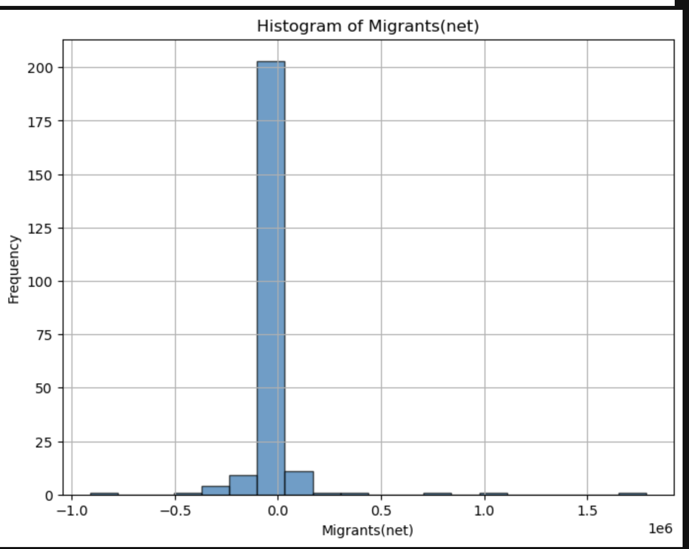
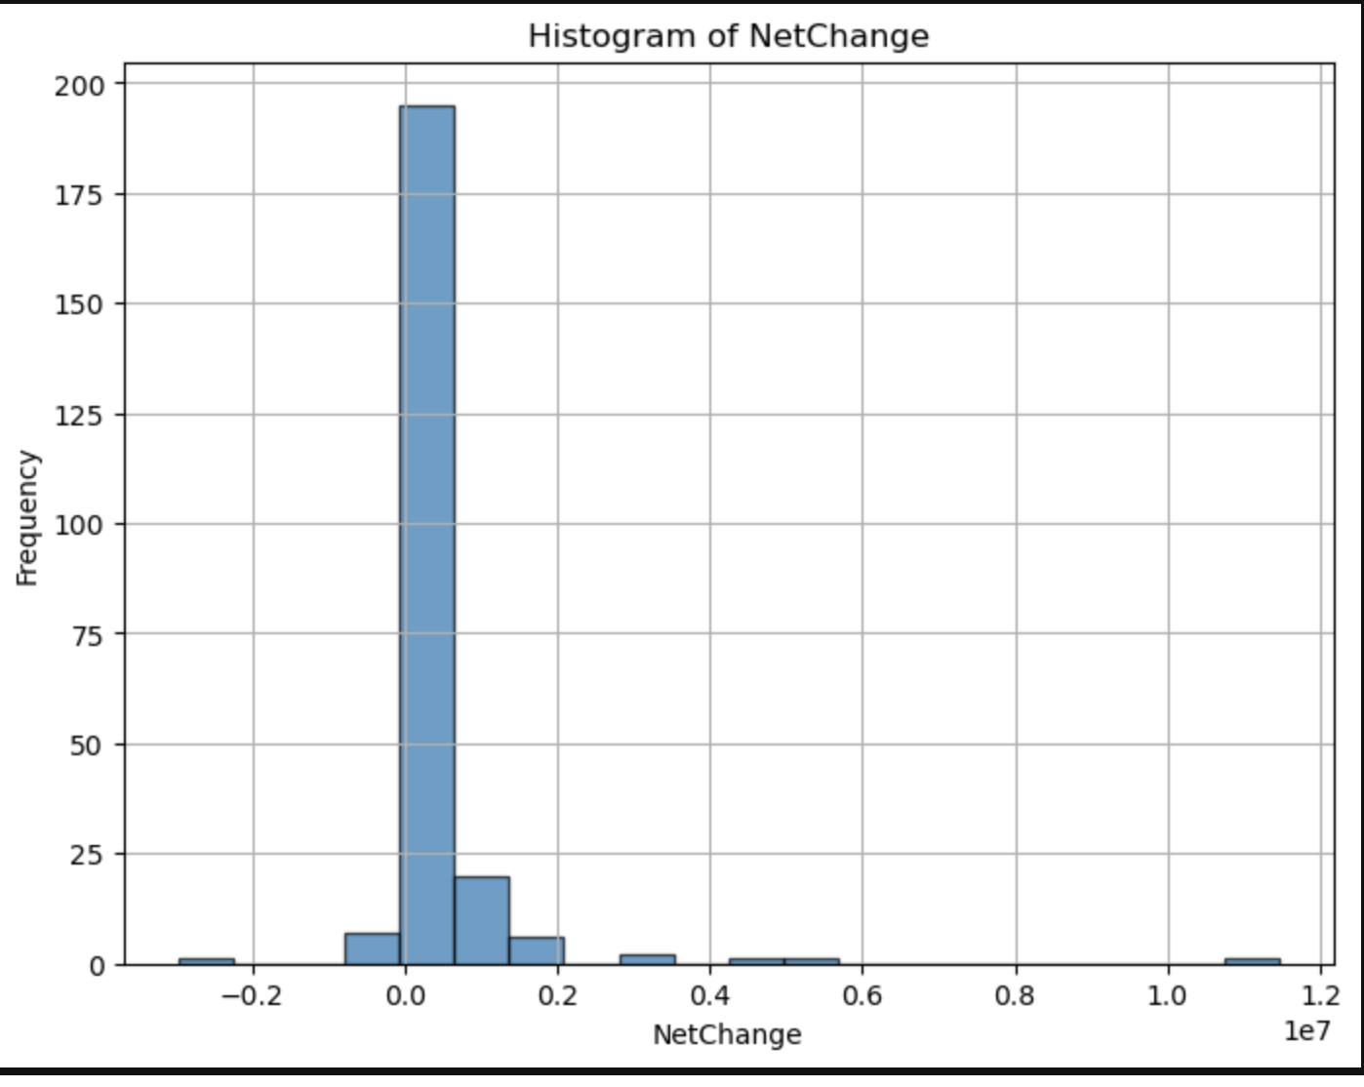
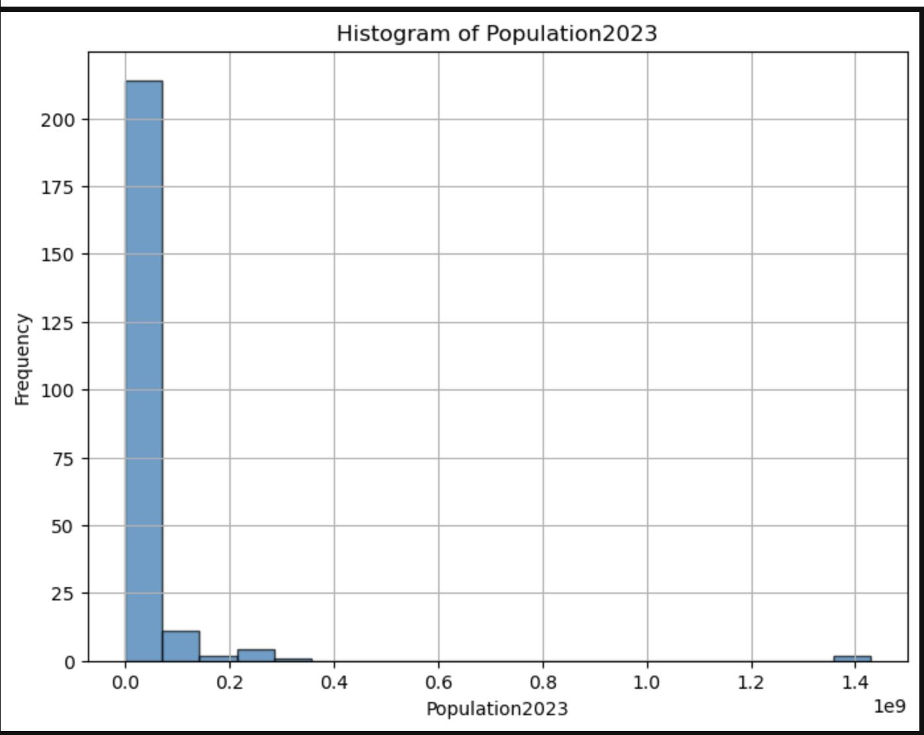
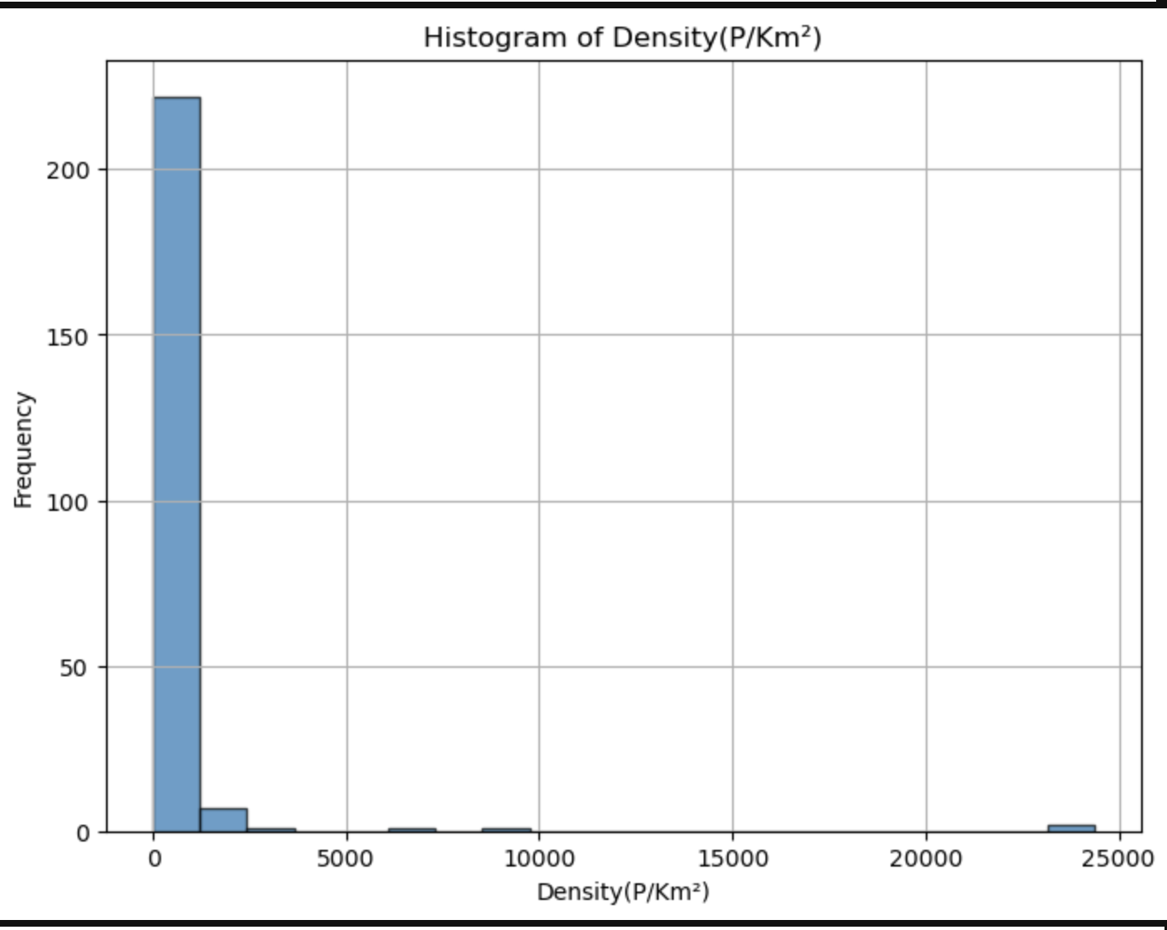
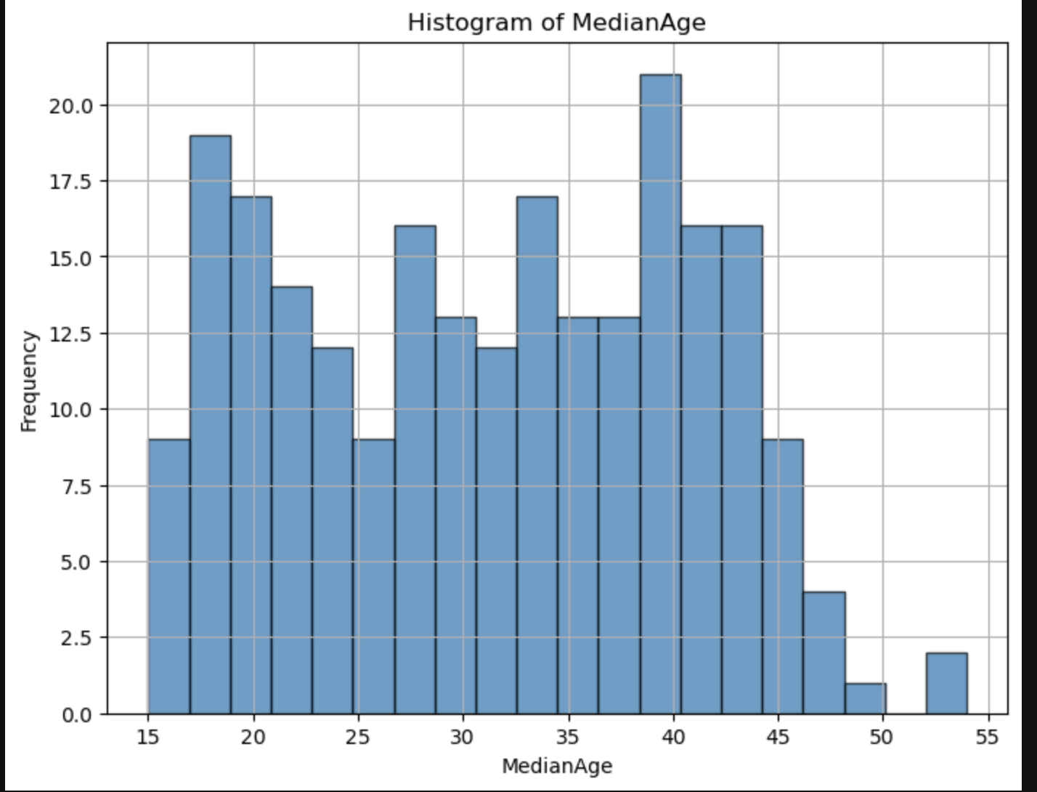
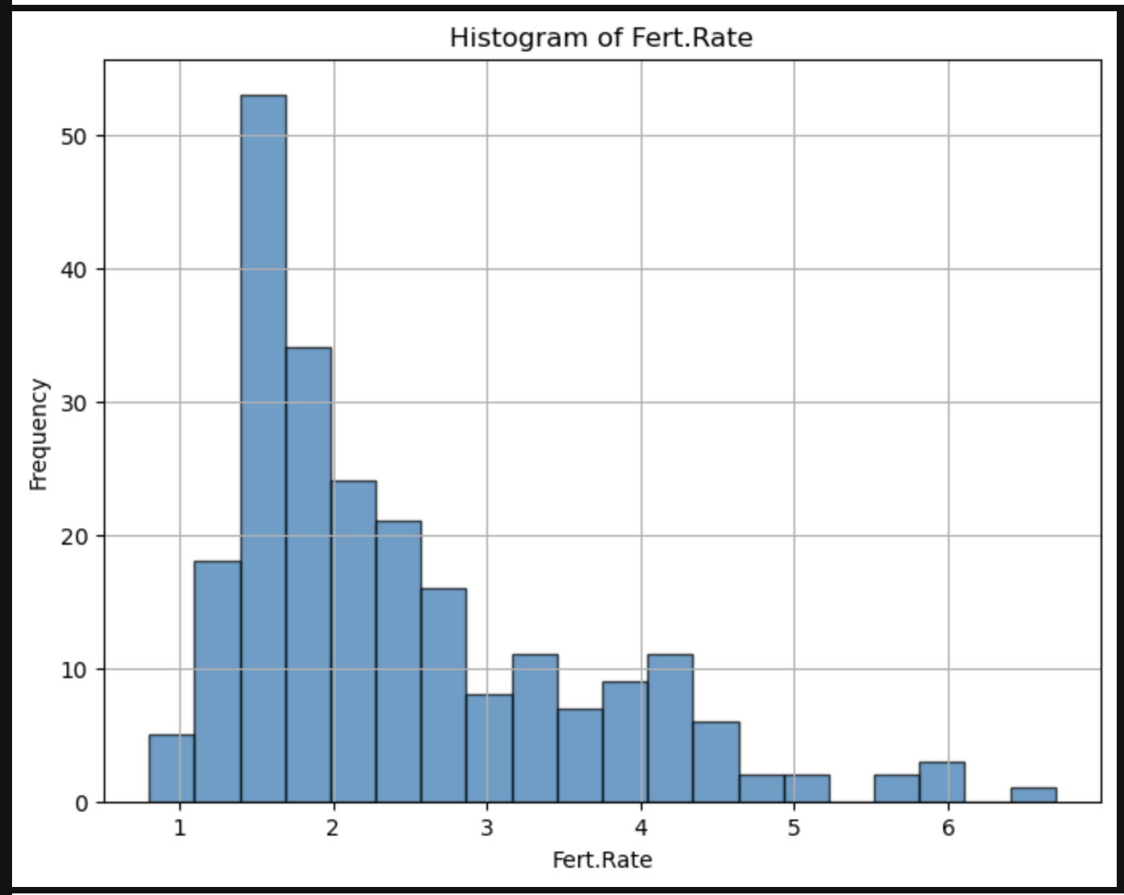

Slide 5
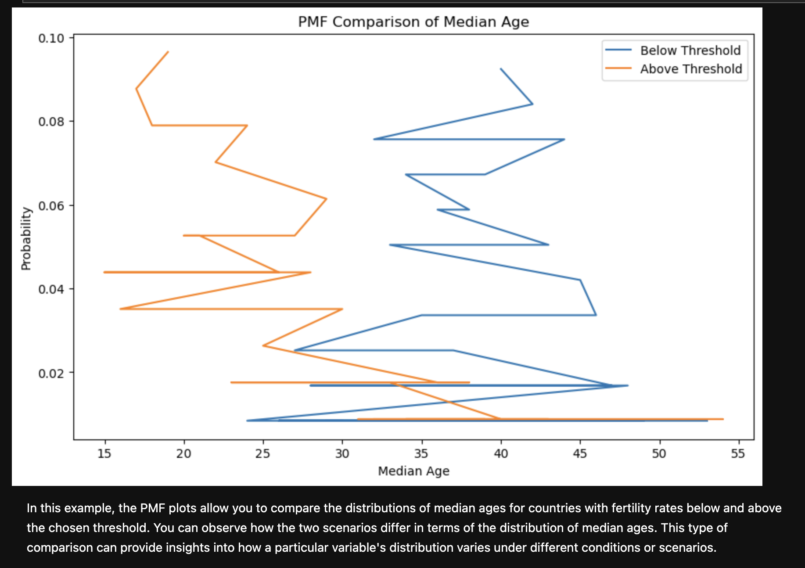
Using pg. 29 of your text as an example, compare two scenarios in your data using a PMF. Reminder, this isn’t comparing two variables against each other – it is the same variable, but a different scenario. Almost like a filter. The example in the book is first babies compared to all other babies, it is still the same variable, but breaking the data out based on criteria we are exploring (Chapter 3).

Slide 6
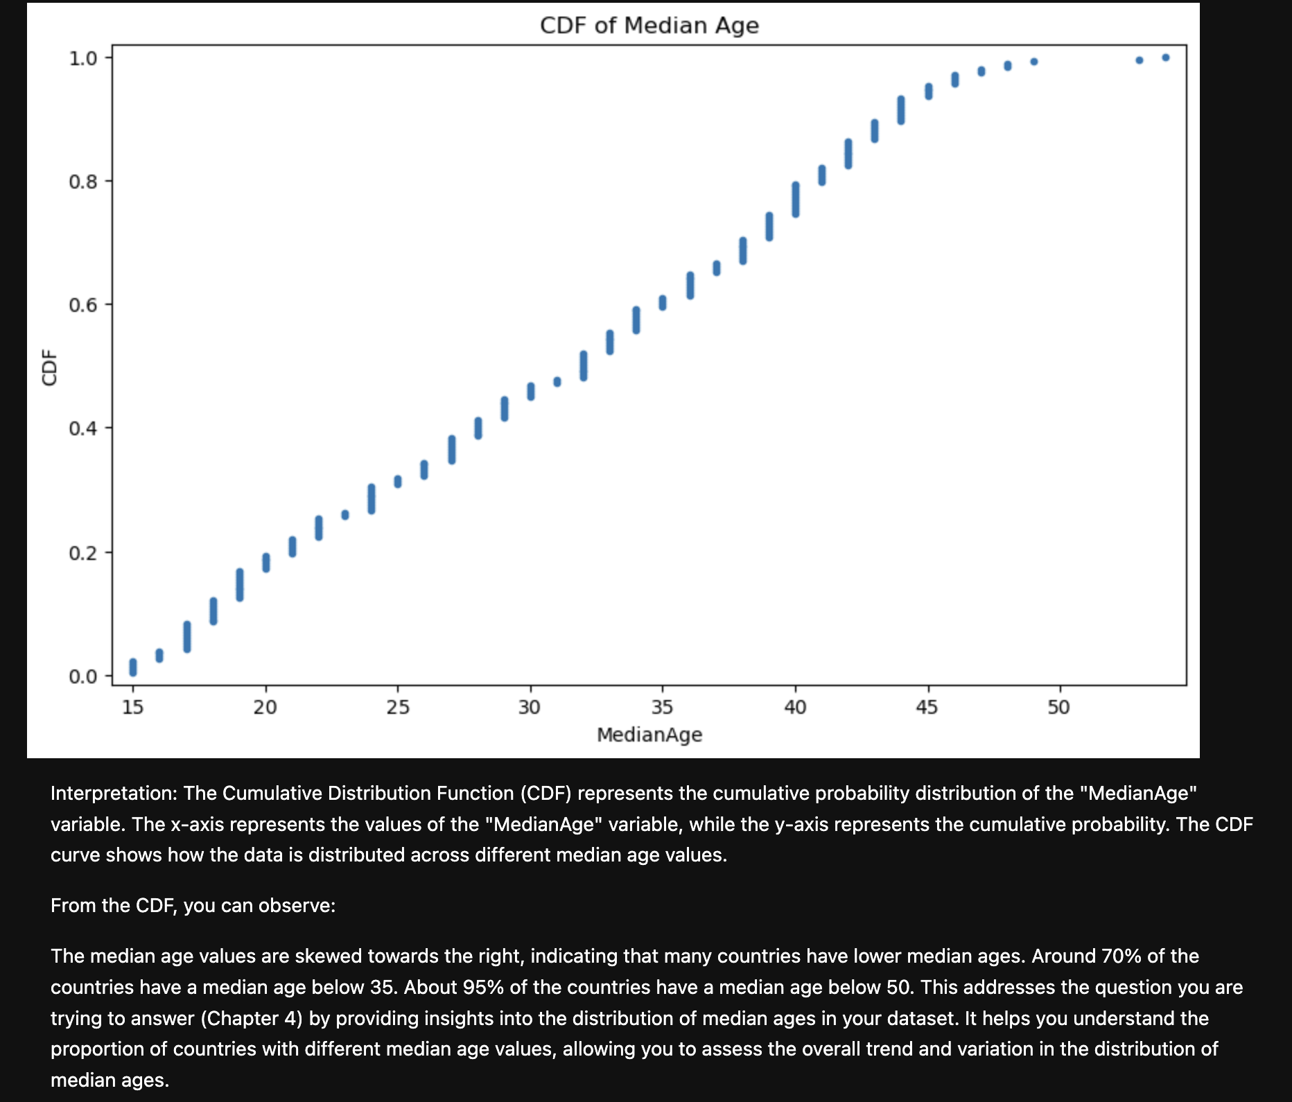
Create 1 CDF with one of your variables, using page 41-44 as your guide, what does this tell you about your variable and how does it address the question you are trying to answer (Chapter 4).

Slide 7
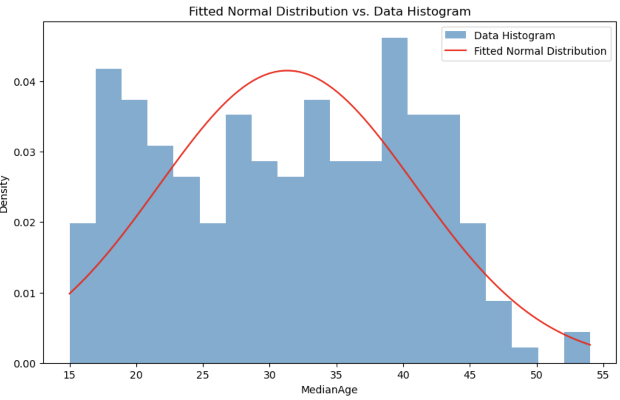
Plot 1 analytical distribution and provide your analysis on how it applies to the dataset you have chosen (Chapter 5).
Median Age ("MedianAge"): The third analytical distribution used is the fitted normal distribution for the "MedianAge" variable. This distribution aims to model the distribution of median ages in your dataset based on a normal distribution.
Analysis: Fitting a normal distribution to the median age data allows you to explore whether the ages in your dataset exhibit a pattern consistent with a Gaussian distribution. By comparing the actual distribution of median ages to the fitted normal distribution, you can identify whether the data closely follows the characteristics of a standard normal distribution or if there are deviations and differences. If the data closely aligns with the fitted normal distribution, it suggests that median ages are distributed similarly to a standard normal distribution. Any deviations could indicate unique age distribution patterns in your dataset.
Analytical distributions, like the fitted normal distribution for the "MedianAge" variable, provide insights into the underlying structure of your data and help you understand how well your data conforms to theoretical distributions. They also serve as a starting point for exploring data characteristics and identifying potential trends or outliers.

Slide 8
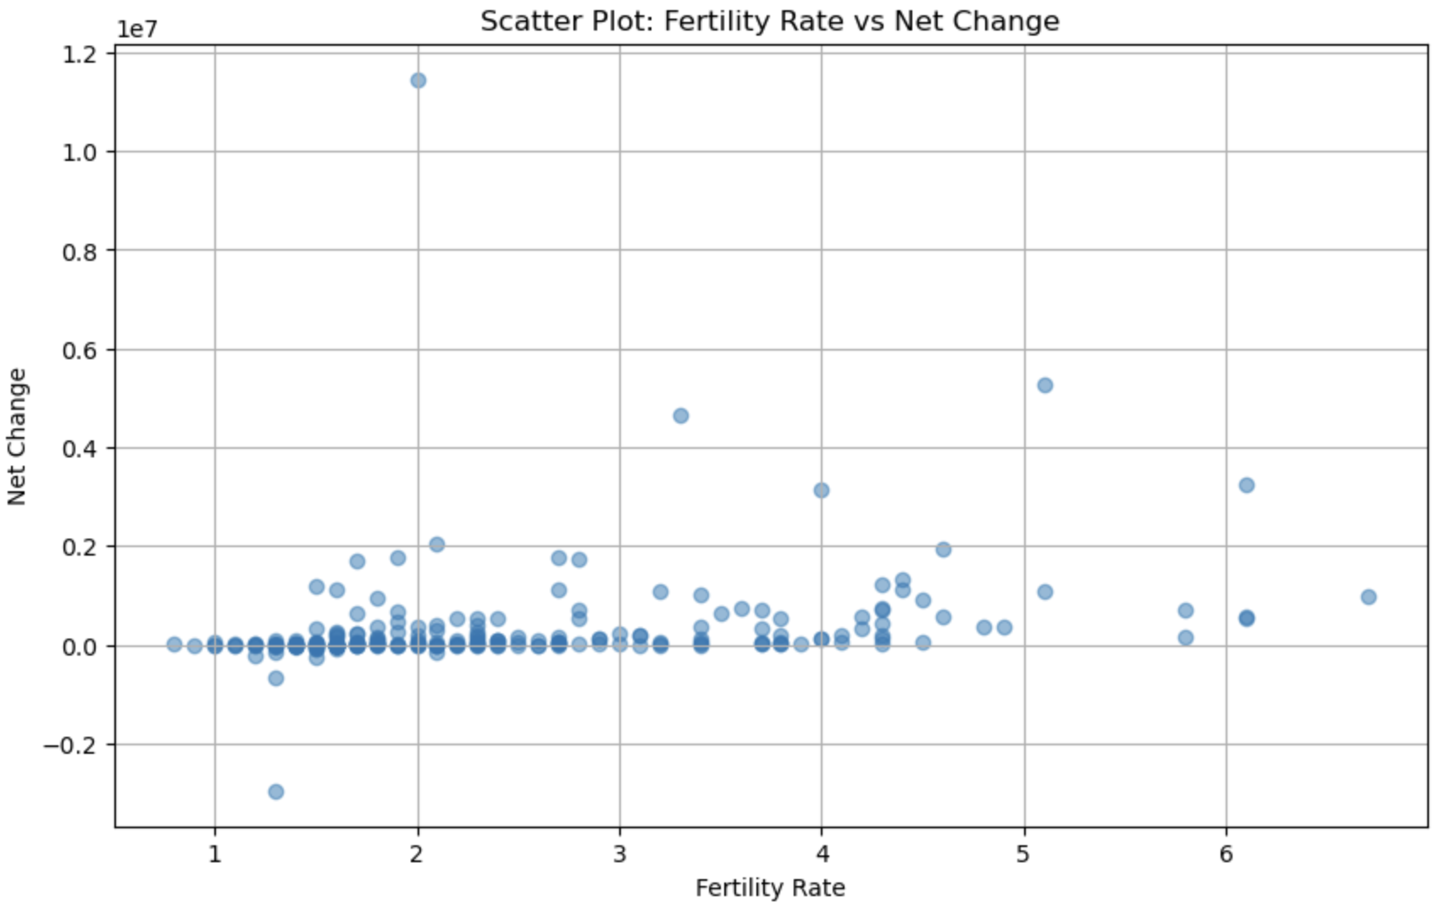
Create two scatter plots comparing two variables and provide your analysis on correlation and causation. Remember, covariance, Pearson’s correlation, and NonLinear Relationships should also be considered during your analysis (Chapter 7).
Analysis:
When analyzing the relationship between fertility rate and net change in population, it's important to consider both correlation and causation:
Covariance and Pearson’s Correlation: Calculate the covariance and Pearson’s correlation coefficient to determine the direction and strength of the linear relationship between the variables. A positive covariance and a positive Pearson’s correlation coefficient suggest that higher fertility rates might be associated with higher net changes in population, and vice versa. However, this doesn't establish causation.
Nonlinear Relationships: Keep in mind that fertility rate and net change in population might exhibit nonlinear relationships. For instance, a country might experience rapid population growth even with moderate changes in fertility rates if there are positive feedback loops (nonlinear relationships) at play.
Causation: To establish causation, a more rigorous analysis is required. Factors like socio-economic conditions, government policies, healthcare access, and cultural norms can all influence both fertility rates and net population changes. Longitudinal studies, controlled experiments, or advanced statistical techniques like regression analysis can help identify causal relationships.
In summary, while correlation between fertility rate and net change in population provides insights into their relationship, it's crucial to exercise caution when inferring causation. Considering covariance, Pearson’s correlation, and nonlinear relationships enriches the analysis and helps avoid drawing unwarranted conclusions about the cause-and-effect nature of the variables.

Slide 9
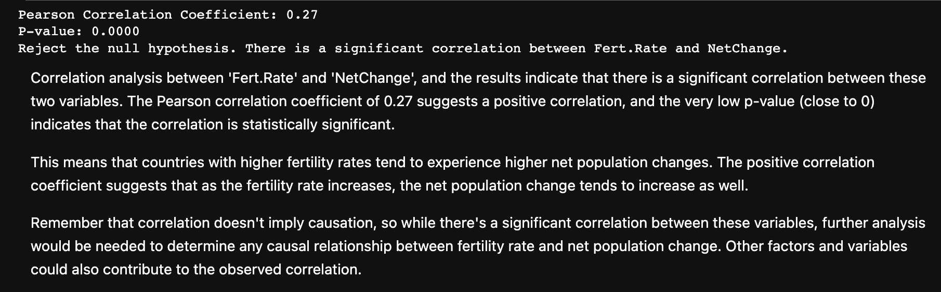
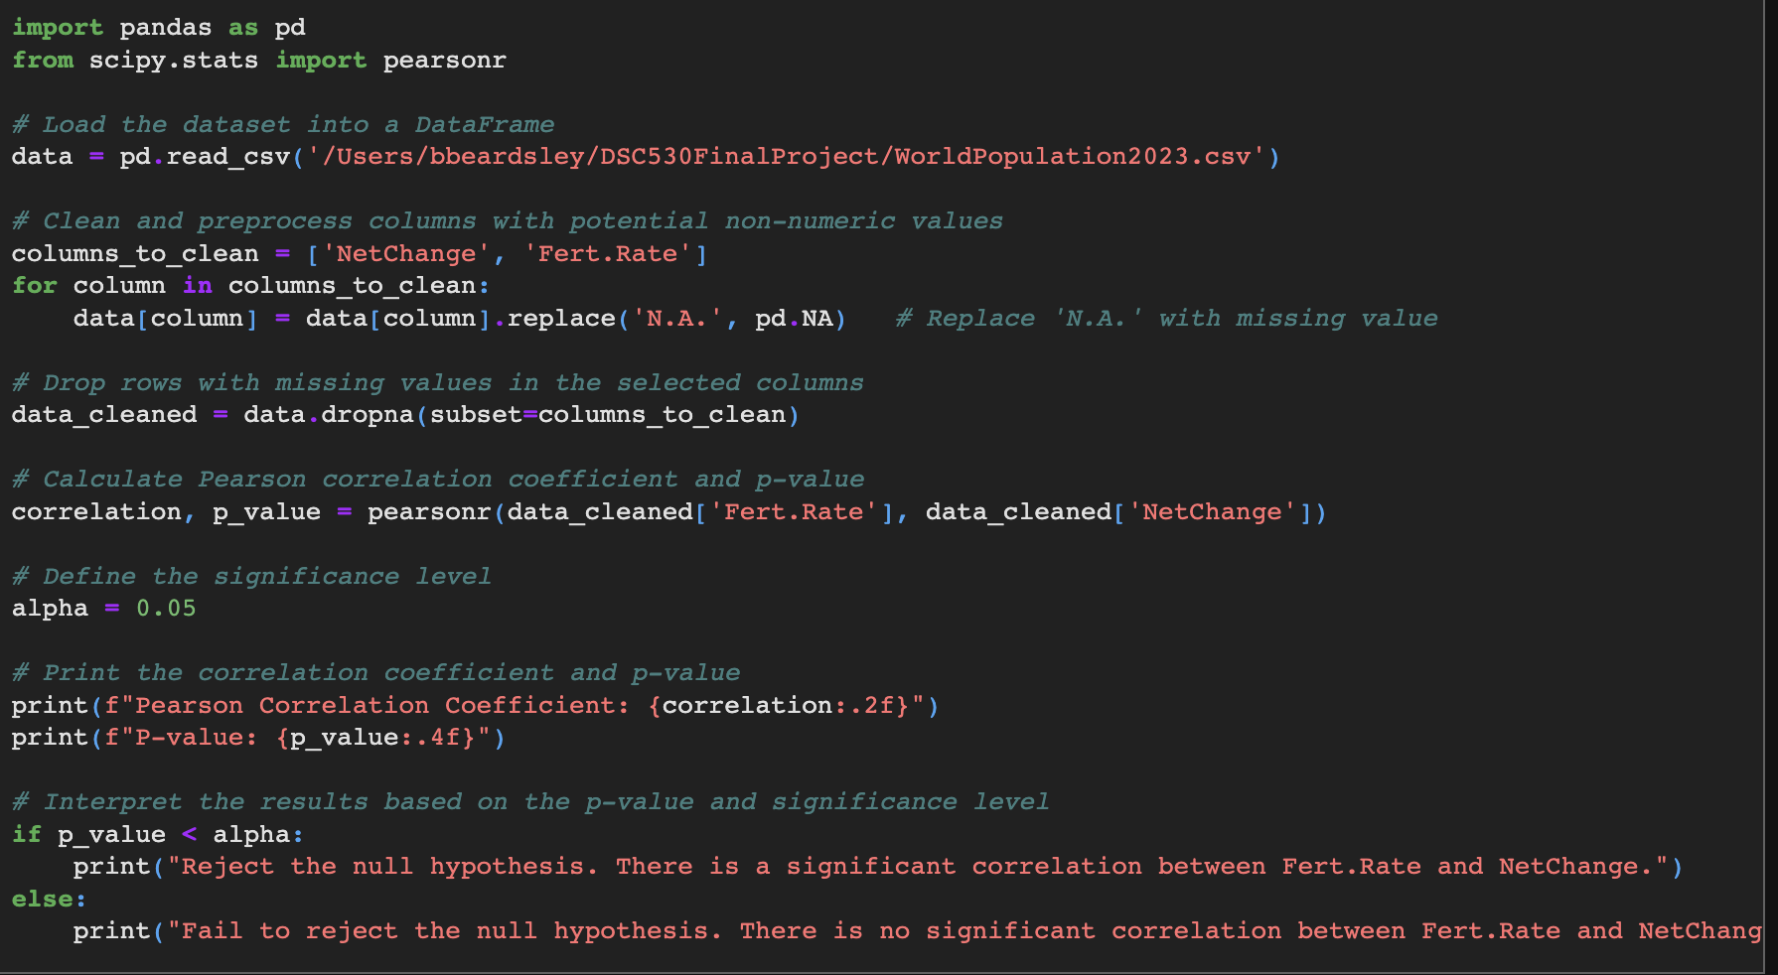
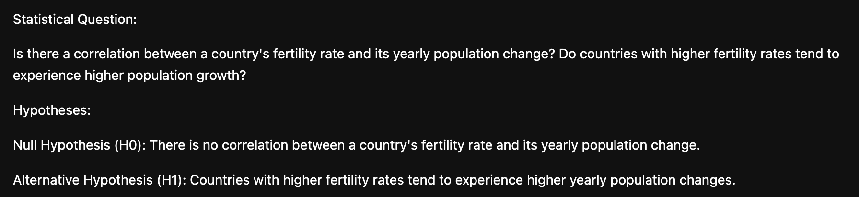
Conduct a test on your hypothesis using one of the methods covered in Chapter 9.

Slide 10
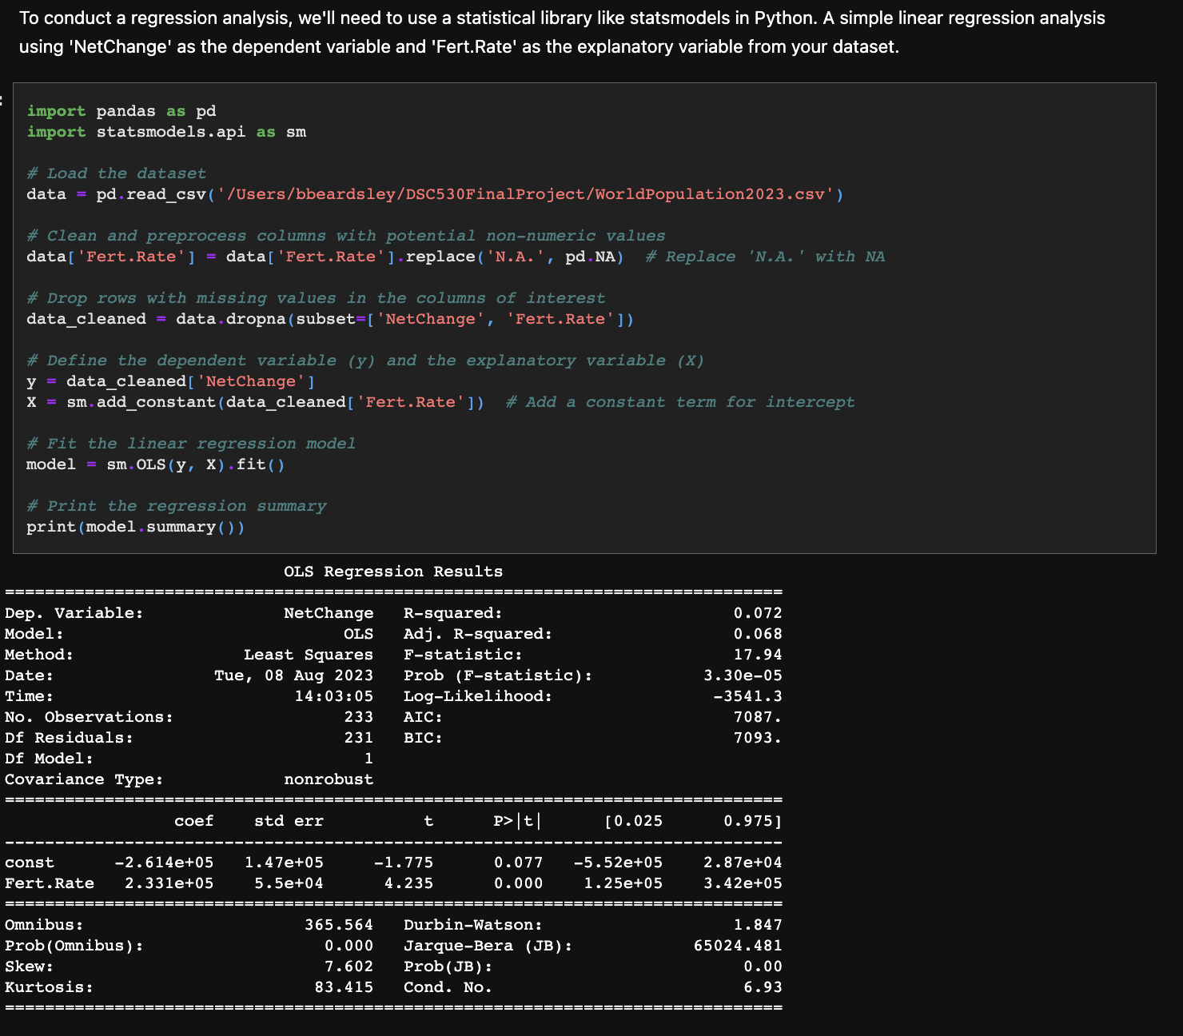
Conduct a regression analysis on either one dependent and one explanatory variable, or multiple explanatory variables (Chapter 10 & 11).

Slide 11
Notes: [1] Standard Errors assume that the covariance matrix of the errors is correctly specified.
The regression analysis results show the relationship between the 'NetChange' (dependent variable) and 'Fert.Rate' (explanatory variable). Here are some key points from the output:
R-squared and Adjusted R-squared: The R-squared value is 0.072, indicating that around 7.2% of the variability in 'NetChange' can be explained by 'Fert.Rate'. The adjusted R-squared, which accounts for the number of variables in the model, is similar.
F-statistic and Prob (F-statistic): The F-statistic is 17.94, and the associated p-value is very close to 0 (3.30e-05). This suggests that at least one of the independent variables (in this case, 'Fert.Rate') has a significant effect on the dependent variable ('NetChange').
Coefficients: The coefficient for 'Fert.Rate' is 2.331e+05. This means that for a one-unit increase in the fertility rate, the net change in population ('NetChange') is estimated to increase by approximately 233,100 people. The constant term ('const') suggests that when the fertility rate is zero, the net change in population is estimated to be -261,400 people.
P-values: Both the p-values for the constant term and 'Fert.Rate' are below 0.05 (commonly used significance level), indicating that both coefficients are statistically significant.
Interpretation: The p-value of 'Fert.Rate' being close to 0 suggests strong evidence that fertility rate is associated with net population change. However, the low R-squared value indicates that fertility rate alone explains only a small portion of the variability in net population change.
Residual Analysis: The Omnibus test (Prob(Omnibus)) and the Jarque-Bera test (Prob(JB)) are used to test for normality of residuals. These tests indicate that the residuals are not normally distributed, suggesting that the model may not fully capture the underlying relationships in the data.
Durbin-Watson: The Durbin-Watson statistic is 1.847, which is close to 2. This suggests that there might not be significant autocorrelation among the residuals.
Overall, the regression analysis indicates a statistically significant relationship between fertility rate and net population change. However, the low R-squared value and non-normality of residuals suggest that the model might not be the best fit for the data. Further analysis and consideration of other variables may be needed to better explain net population change.

